Slide 1
Auditing the client’s website

Slide 2
Auditing the client’s website
To optimize a website, you have to be able to identify areas of improvement.
This means analyzing the number of requests on a page, the amount of data the page contains, and the amount of time it takes for the page to load.
This is where Chrome’s network tools come in handy.
how to create waterfall charts with these tools and how to quantify aspects of your client’s website so that you have a starting point for optimizing.

Slide 3
Auditing the client’s website
Chrome’s network tools are accessible in the same place where you chose a network throttling profile, which is under the Network tab.
The first thing you’ll want to do in the Network tab is ensure that the Disable cache check box is selected. When a website is first visited, none of the assets are cached, and this is the scenario that you want to be able to replicate. Otherwise, the site’s assets will be served from the cache. Although a site loads faster when cached, it’s best to assume that your average user won’t have your site assets cached.

Slide 4
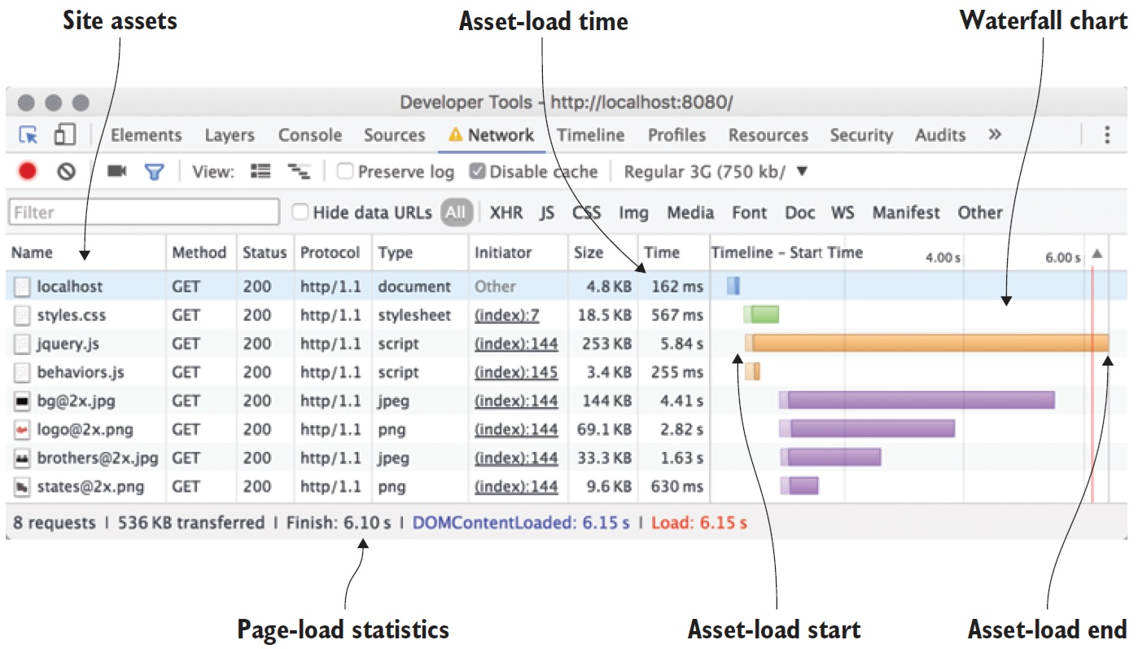

Slide 5
Client website’s load time can differ not only because of the quality of its network connection, but also because of the characteristics of the device itself. Depending on the site visited, devices with higher display densities may download more data than devices with standard displays.
As you proceed in performance-tuning the client’s website, you’ll keep tabs on load times and the amount of data you reduce for each scenario as it pertains to the Regular 3G throttling profile you’ve chosen.

Slide 6
Optimizing the client’s website
When improving the performance of a website, the goal is simple: reduce the amount of data transferred. By pursuing this, you’ll decrease the amount of time that the site loads on any device. The best part of this pursuit is that it benefits the user on both HTTP/1 and HTTP/2 servers. If there’s one piece of advice that always wins out, it’s this: fewer bytes transferred means faster load times.

Slide 7
Optimizing the client’s website
In these optimization efforts, you’ll start by minifying the assets of the site, which includes the CSS, the JavaScript, and the HTML itself. Then you’ll move on to optimize the images on the site without compromising their visual integrity. Finally, you’ll finish by employing compression on the server for text assets.

Slide 8
Minifying assets
Minification is a process by which all whitespace and unnecessary characters are stripped from a text-based asset without affecting the way that asset functions.
Many human-readable files such as CSS and JavaScript contain whitespace and characters that are inserted by developers during development. We use line breaks and indentation in our CSS and JavaScript to make them easier to read, as well as using comments in source code for documentation purposes.
Web browsers need no such help when reading these files. The fewer unnecessary characters that are in these files, the faster the web browser will download and parse them.

Slide 9
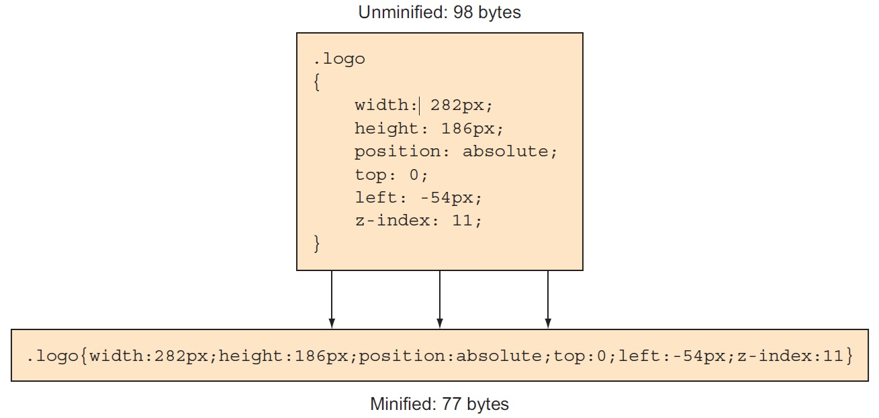

Slide 10
Minifying assets Online Websites
https://www.toptal.com/developers/cssminifier
https://www.cleancss.com/css-minify/
https://www.tutorialsteacher.com/tools/css-minifier
https://www.toptal.com/developers/javascript-minifier
https://www.minifier.org/
https://www.toptal.com/developers/html-minifier
http://kangax.github.io/html-minifier/
https://codebeautify.org/minify-html
https://www.atatus.com/tools/html-minify

Slide 11
Using server compression
Surely you’ve been emailed compressed files. These files are often used in online communications as a handy way to package multiple files into a single one. Aside from the convenience of consolidation, compressing files can also reduce their size. Server compression works on a similar principle with respect to reduction of file sizes, and web browsers are able to accept and decompress compressed content on behalf of the user.

Slide 12
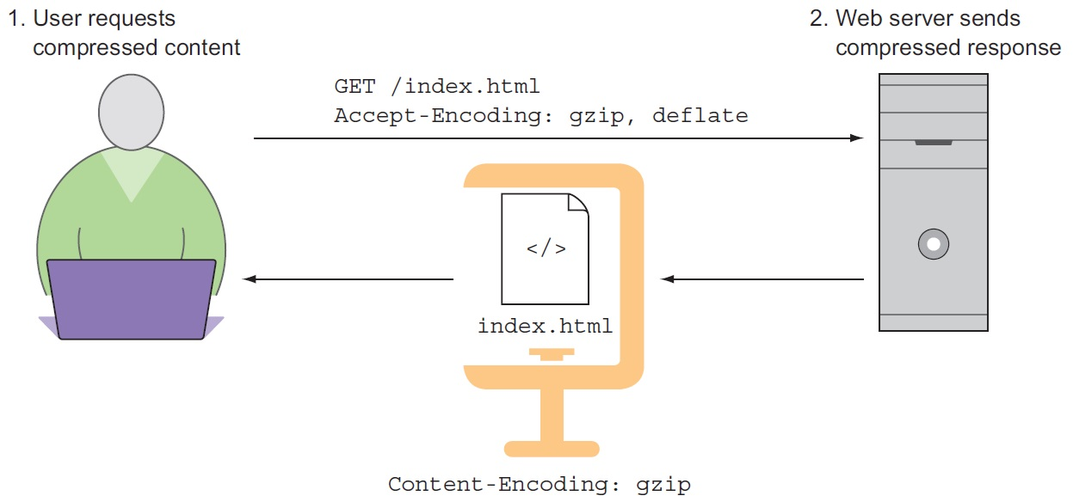
Using server compression

Slide 13
Using server compression
Server compression works as follows: A user requests a web page from a server. The user’s request is accompanied by an Accept-Encoding header that tells the server the compression formats the browser is capable of using. If the server is capable of encoding the content as indicated in the Accept-Encoding header, it will reply with a Content-Encoding header that describes the compression method used along with the compressed content.

Slide 14
Using server compression
This is useful because much of the content that’s downloaded from websites tends to be text, which compresses well. A compression method called gzip has nearly universal browser support, and is very effective in reducing the size of text assets. In this step of optimizing your client’s website, you’ll configure your server to serve compressed content.

Slide 15
Optimizing images
Image compression has come a long way since the days of Photoshop’s Save for Web dialog box. Today’s algorithms are so efficient at reducing the file size of full-color images that the end result is usually indistinguishable from the source image. The savings in file size, however, can be significant.

Slide 16
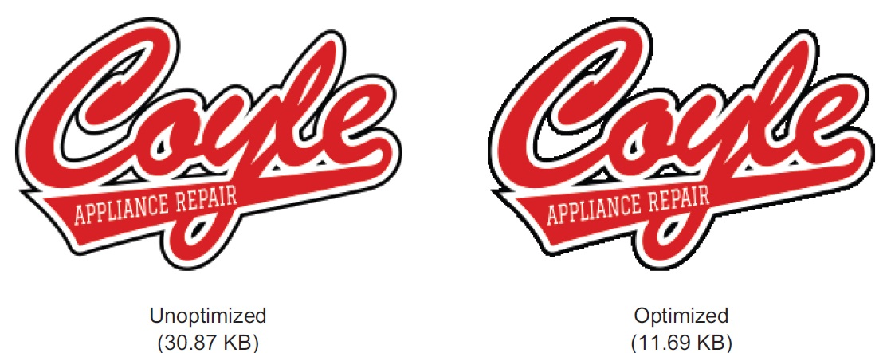
Optimizing images

Slide 17
Optimizing images Online Websites
https://tinypng.com/
https://imagecompressor.com/
https://www.iloveimg.com/compress-image
https://imageresizer.com/image-compressor
https://compressnow.com/
https://shortpixel.com/online-image-compression
https://www.img2go.com/compress-image
https://compressjpeg.com/

Slide 18
Summary
You then set to work by improving a client’s website through the following techniques:
Analyzing the weight of a page by using the Developer Tools in Google Chrome
Reducing the size of text-based assets by a process called minification, which strips unnecessary whitespace from assets without affecting their function
Further reducing the size of these text assets through server compression
Measuring the effectiveness of optimizing images

Slide 19
Using assessment tools
Evaluating with Google PageSpeed Insights:
It won’t surprise you to know that Google cares about web performance. As early as 2010, Google indicated in a blog post that performance is a factor in a site’s ranking in organic search results. If you’re running a content-driven site that gets most of its traffic from search engines, this should give you pause. Fortunately, Google has an assessment tool: PageSpeed Insights.

Slide 20
Google PageSpeed Insights analyzes a website and gives tips on how to improve its performance and user experience. When PageSpeed Insights renders its analysis, it does so twice: once with a mobile user agent and then with a desktop user agent. It analyzes performance with two criteria in mind: the time it takes for above-the-fold content to load, and the time it takes for the entire page to load.

Slide 21
Performance METRICS
First Contentful Paint (FCP):
First Contentful Paint marks the time at which the first text or image is painted. FCP measures how long it takes the browser to render the first piece of DOM content after a user navigates to your page. Images, non-white <canvas> elements, and SVGs on your page are considered DOM content; anything inside an iframe isn't included.
FCP time (in seconds) | Color-coding
0–1.8 | Green (fast)
1.8–3 | Orange (moderate)
Over 3 | Red (slow)

Slide 22
Largest Contentful Paint (LCP):
Largest Contentful Paint marks the time at which the largest text or image is painted. LCP measures when the largest content element in the viewport is rendered to the screen. This approximates when the main content of the page is visible to users.
LCP time (in seconds) | Color-coding
0-2.5 | Green (fast)
2.5-4 | Orange (moderate)
Over 4 | Red (slow)

Slide 23
Total Blocking Time (TBT):
Sum of all time periods between FCP and Time to Interactive, when task length exceeded 50ms, expressed in milliseconds. TBT measures the total amount of time that a page is blocked from responding to user input, such as mouse clicks, screen taps, or keyboard presses.
TBT time (in milliseconds) | Color-coding
0–200 | Green (fast)
200-600 | Orange (moderate)
Over 600 | Red (slow)

Slide 24

Cumulative Layout Shift (CLS):
Cumulative Layout Shift measures the movement of visible elements within the viewport. To provide a good user experience, sites should strive to have a CLS score of 0.1 or less. To ensure you're hitting this target for most of your users, a good threshold to measure is the 75th percentile of page loads, segmented across mobile and desktop devices.

Slide 25
Speed Index (SI):
Speed Index shows how quickly the contents of a page are visibly populated. Speed Index measures how quickly content is visually displayed during page load.
Speed Index (in seconds) | Color-coding
0–3.4 | Green (fast)
3.4–5.8 | Orange (moderate)
Over 5.8 | Red (slow)

Slide 26
Time to Interactive (TTI) :
It is one of six metrics tracked in the Performance section of the Lighthouse report. Each metric captures some aspect of page load speed. Measuring TTI is important because some sites optimize content visibility at the expense of interactivity. This can create a frustrating user experience: the site appears to be ready, but when the user tries to interact with it, nothing happens.
TTI metric (in seconds) | Color-coding
0–3.8 | Green (fast)
3.9–7.3 | Orange (moderate)
Over 7.3 | Red (slow)

Slide 27
Using Google Analytics for bulk reporting
If you’re a professional web developer, chances are good that you’ve used Google Analytics. This reporting tool provides data on your site’s visitors, such as where they’re located, how they got to your site, how much time they’ve spent there, and other statistics.
If you have Google Analytics on your site already, all you have to do is log in and follow along. If you haven’t installed it on your site, sign in with a Google account at www.google.com/analytics and follow the instructions. The process takes little time and involves pasting a small bit of JavaScript code into your site’s HTML. From there, you need to wait a day or two for Google Analytics to gather data.

Slide 28

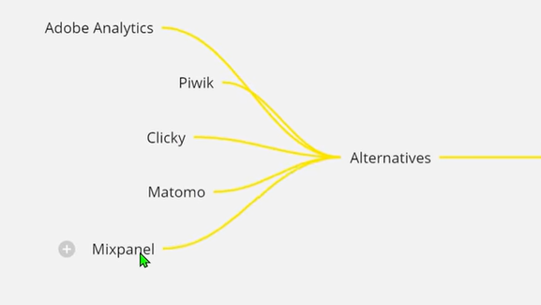
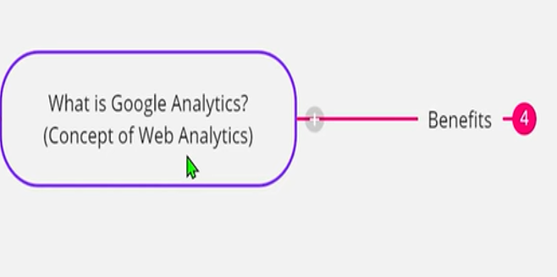

Slide 29
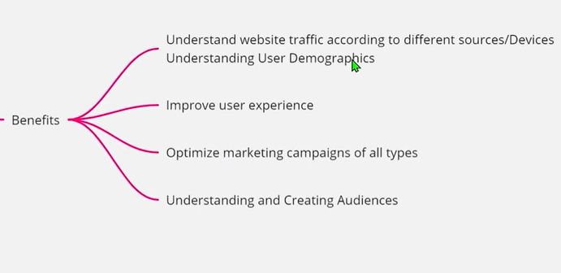

Slide 30
After you’ve logged in, you’ll be redirected to the website’s dashboard. Go to the Behavior section in the left-hand menu and expand it to reveal a submenu. Upon entering this section, you’ll see a dashboard with performance statistics. This includes a line graph plotting the average load times of all visits for pages on the site in the last reporting period, as well as a table with the following columns:

Slide 31
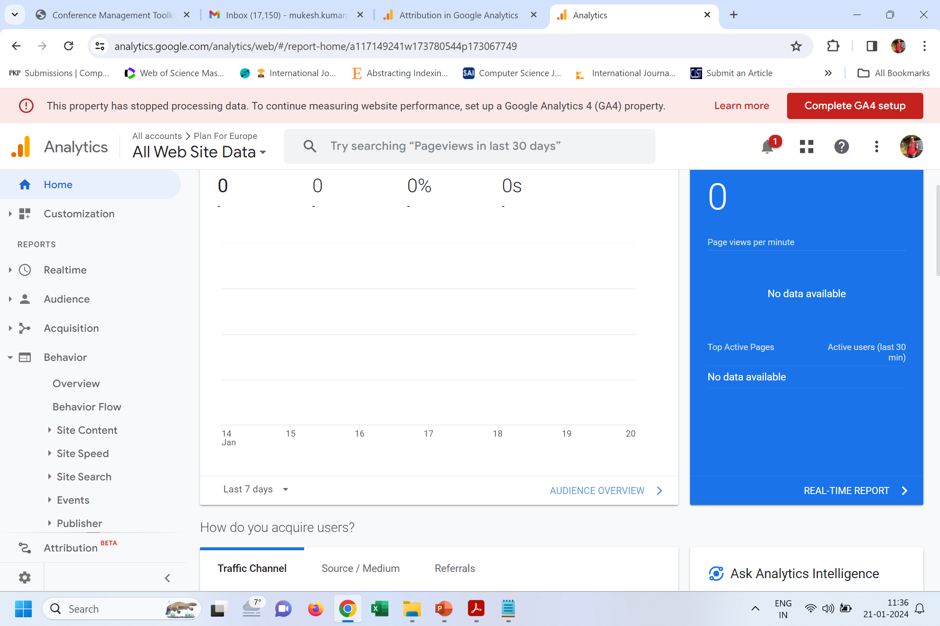

Slide 32
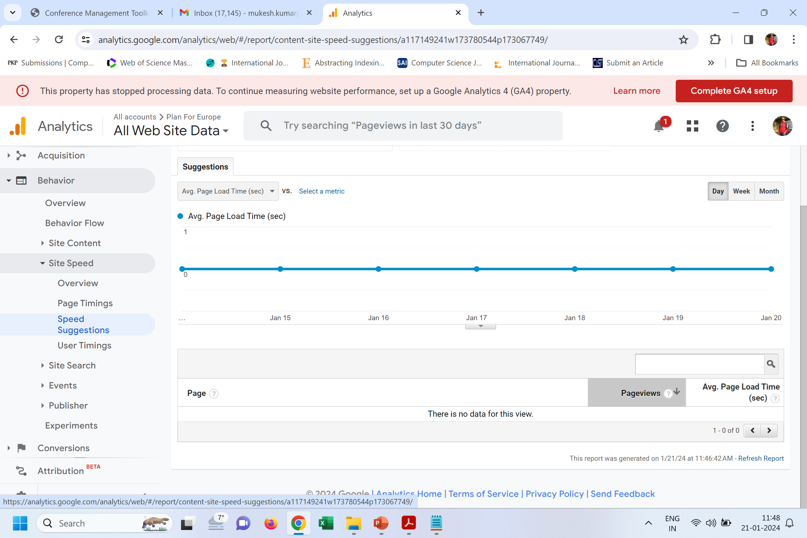

Slide 33
Upon entering this section, you’ll see a dashboard with performance statistics, as shown in figure. This includes a line graph plotting the average load times of all visits for pages on the site in the last reporting period, as well as a table with the following columns:
Page: The URL of the page.
Pageviews: The number of views a page has received in the reporting period. The reporting period is usually the preceding month but can be changed to a custom time period.
Avg. Page Load Time: The average number of seconds the page has taken to load.

Slide 34
PageSpeed Suggestions: The number of suggestions PageSpeed Insights has to improve the performance of the associated page URL. Clicking this value directs you to a new window containing a PageSpeed Insights report for that specific URL.
PageSpeed Score: The score given by the PageSpeed Insights report. This score is expressed in a range from 1 to 100, with lower scores indicating room for improvement, and higher scores indicating positive performance characteristics.

Slide 35
Using browser-based assessment tools
Numerous tools are available in your desktop browser. All browsers ship with a set of developer tools. All of them share functionality, but each has or lacks something in comparison to its competitors. The browsers we touch upon Google Chrome, Mozilla Firefox, Safari, and Microsoft Edge, with a specific focus on Chrome’s Developer Tools.

Slide 36
Inspecting network requests
We used Chrome’s network utility to generate a waterfall chart of the site’s assets and to measure page load time. Most network inspection tools in the browser work similarly to Chrome’s in that they generate waterfall charts, but the functionality only begins there. This section explains how to use the utility to view timing information of individual assets, as well as how to view HTTP headers.

Slide 37
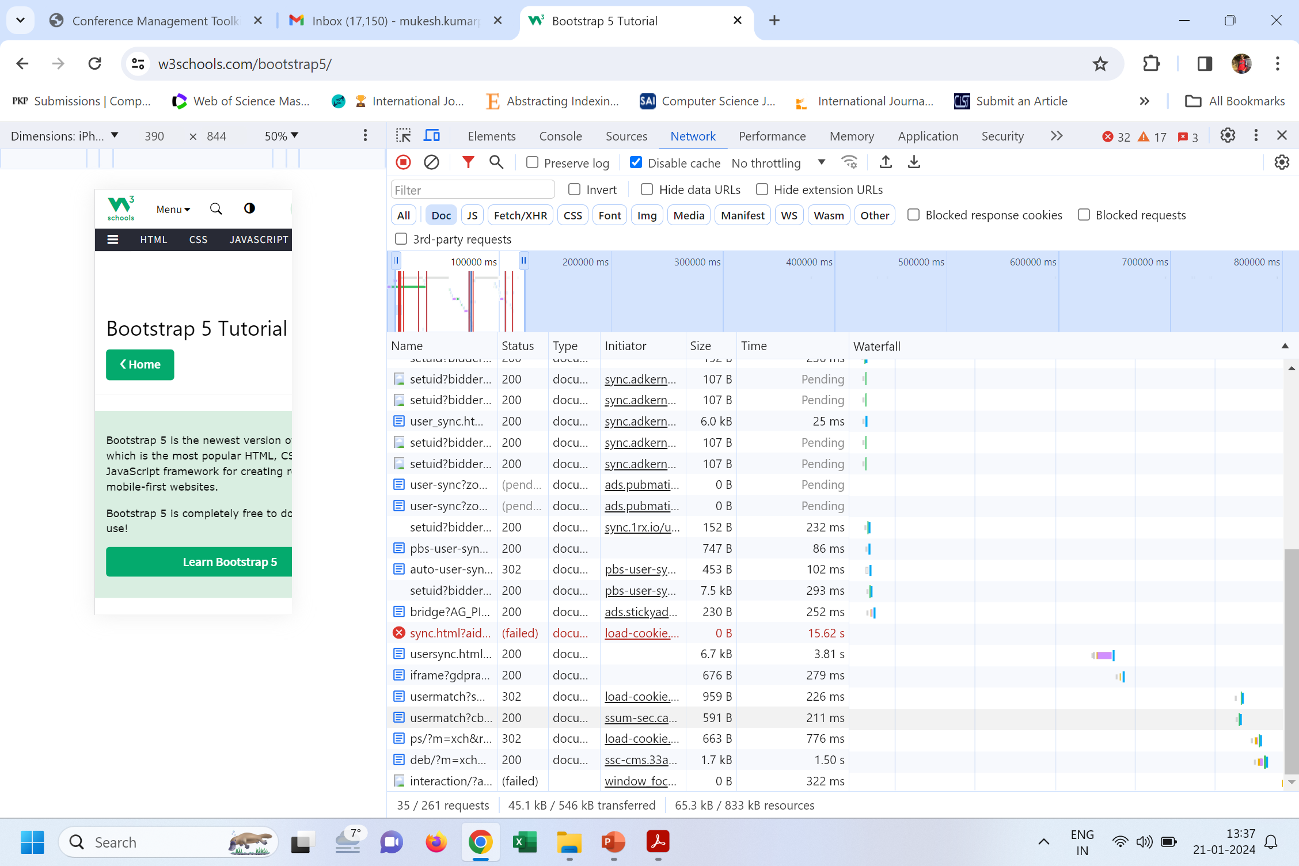

Slide 38
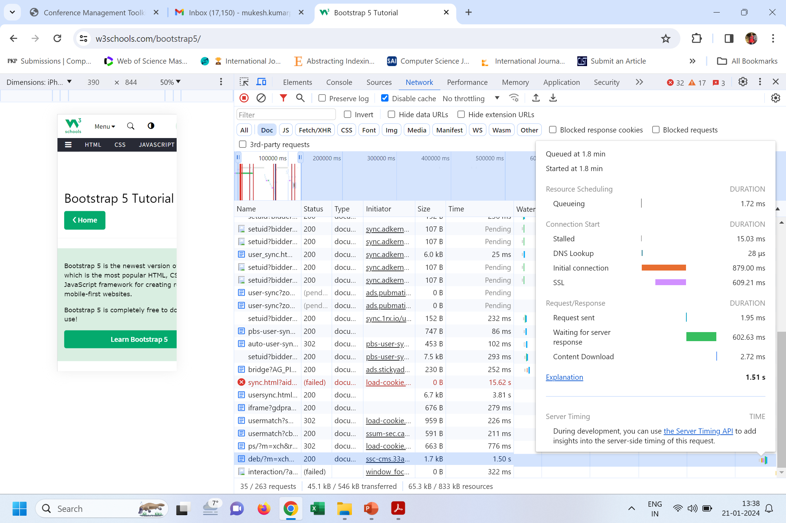

Slide 39
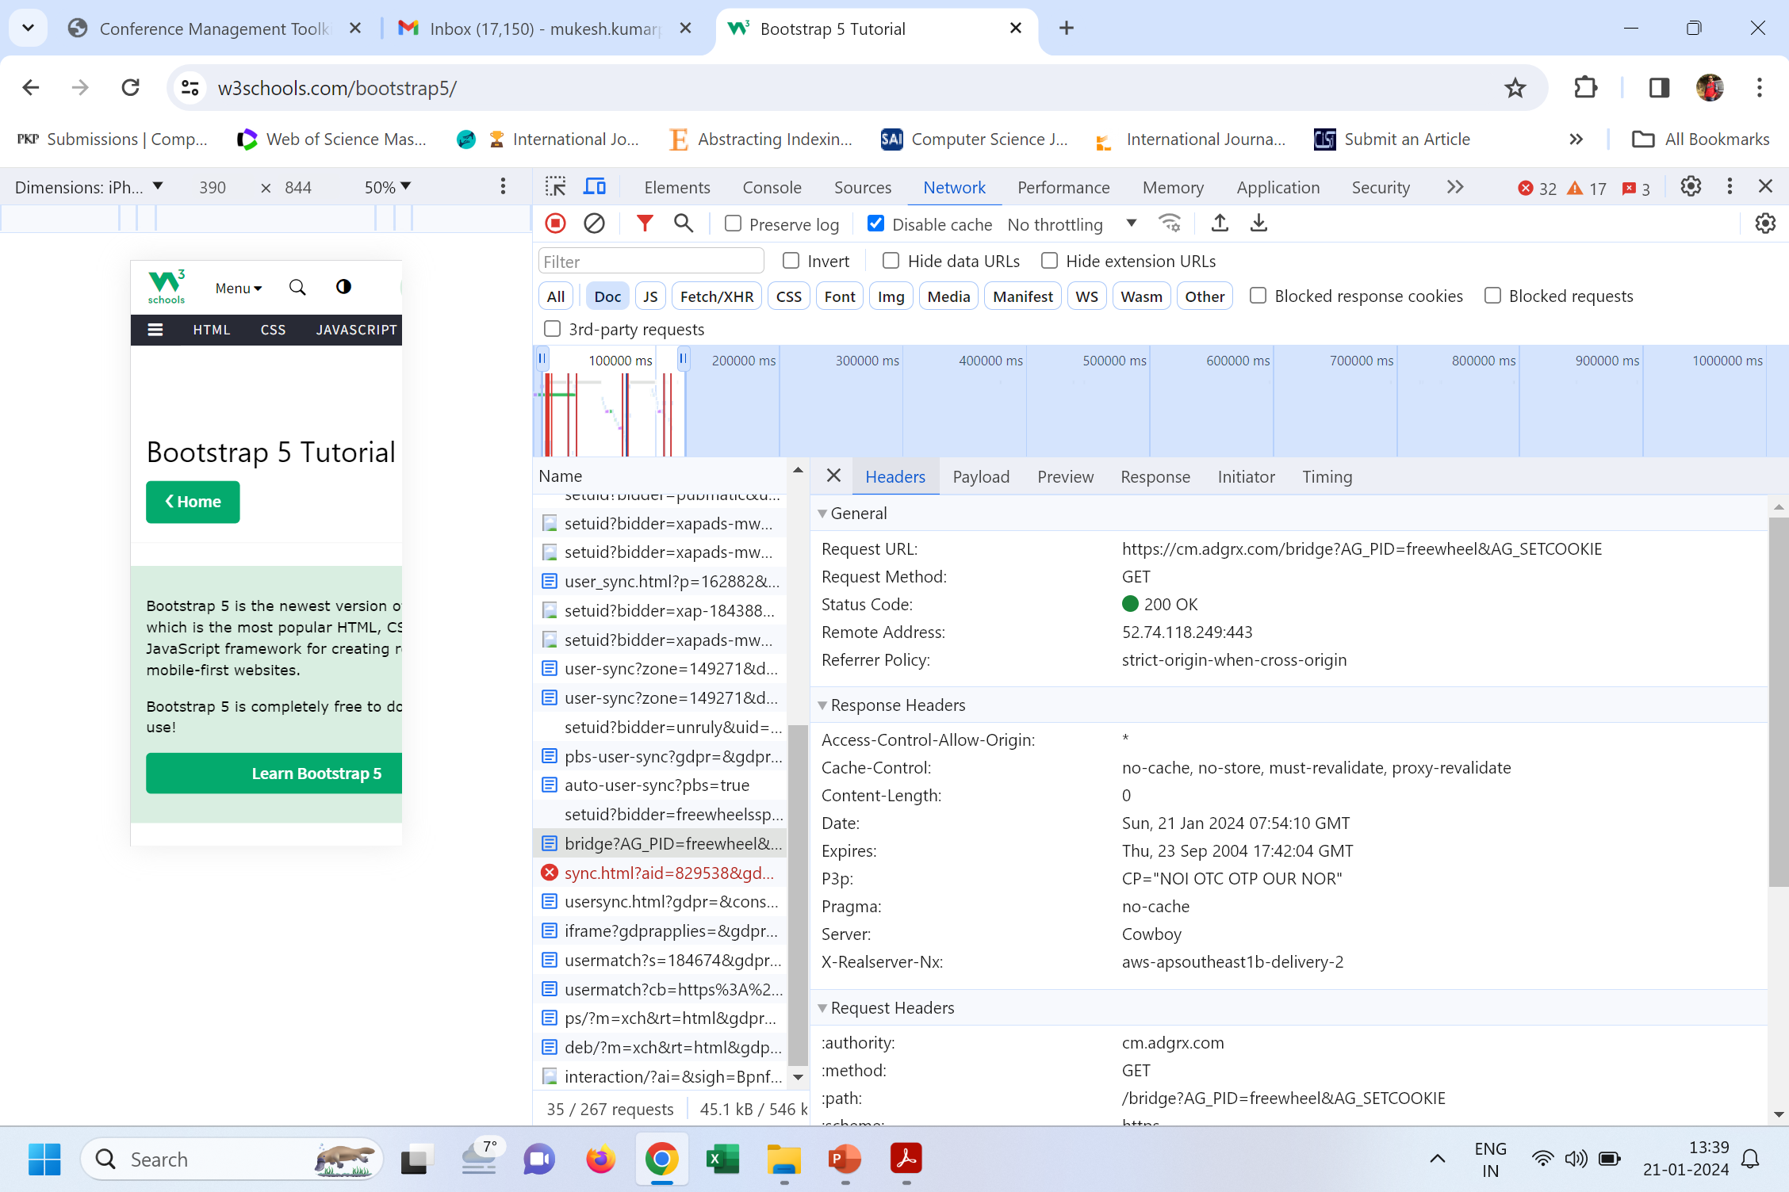

Slide 40
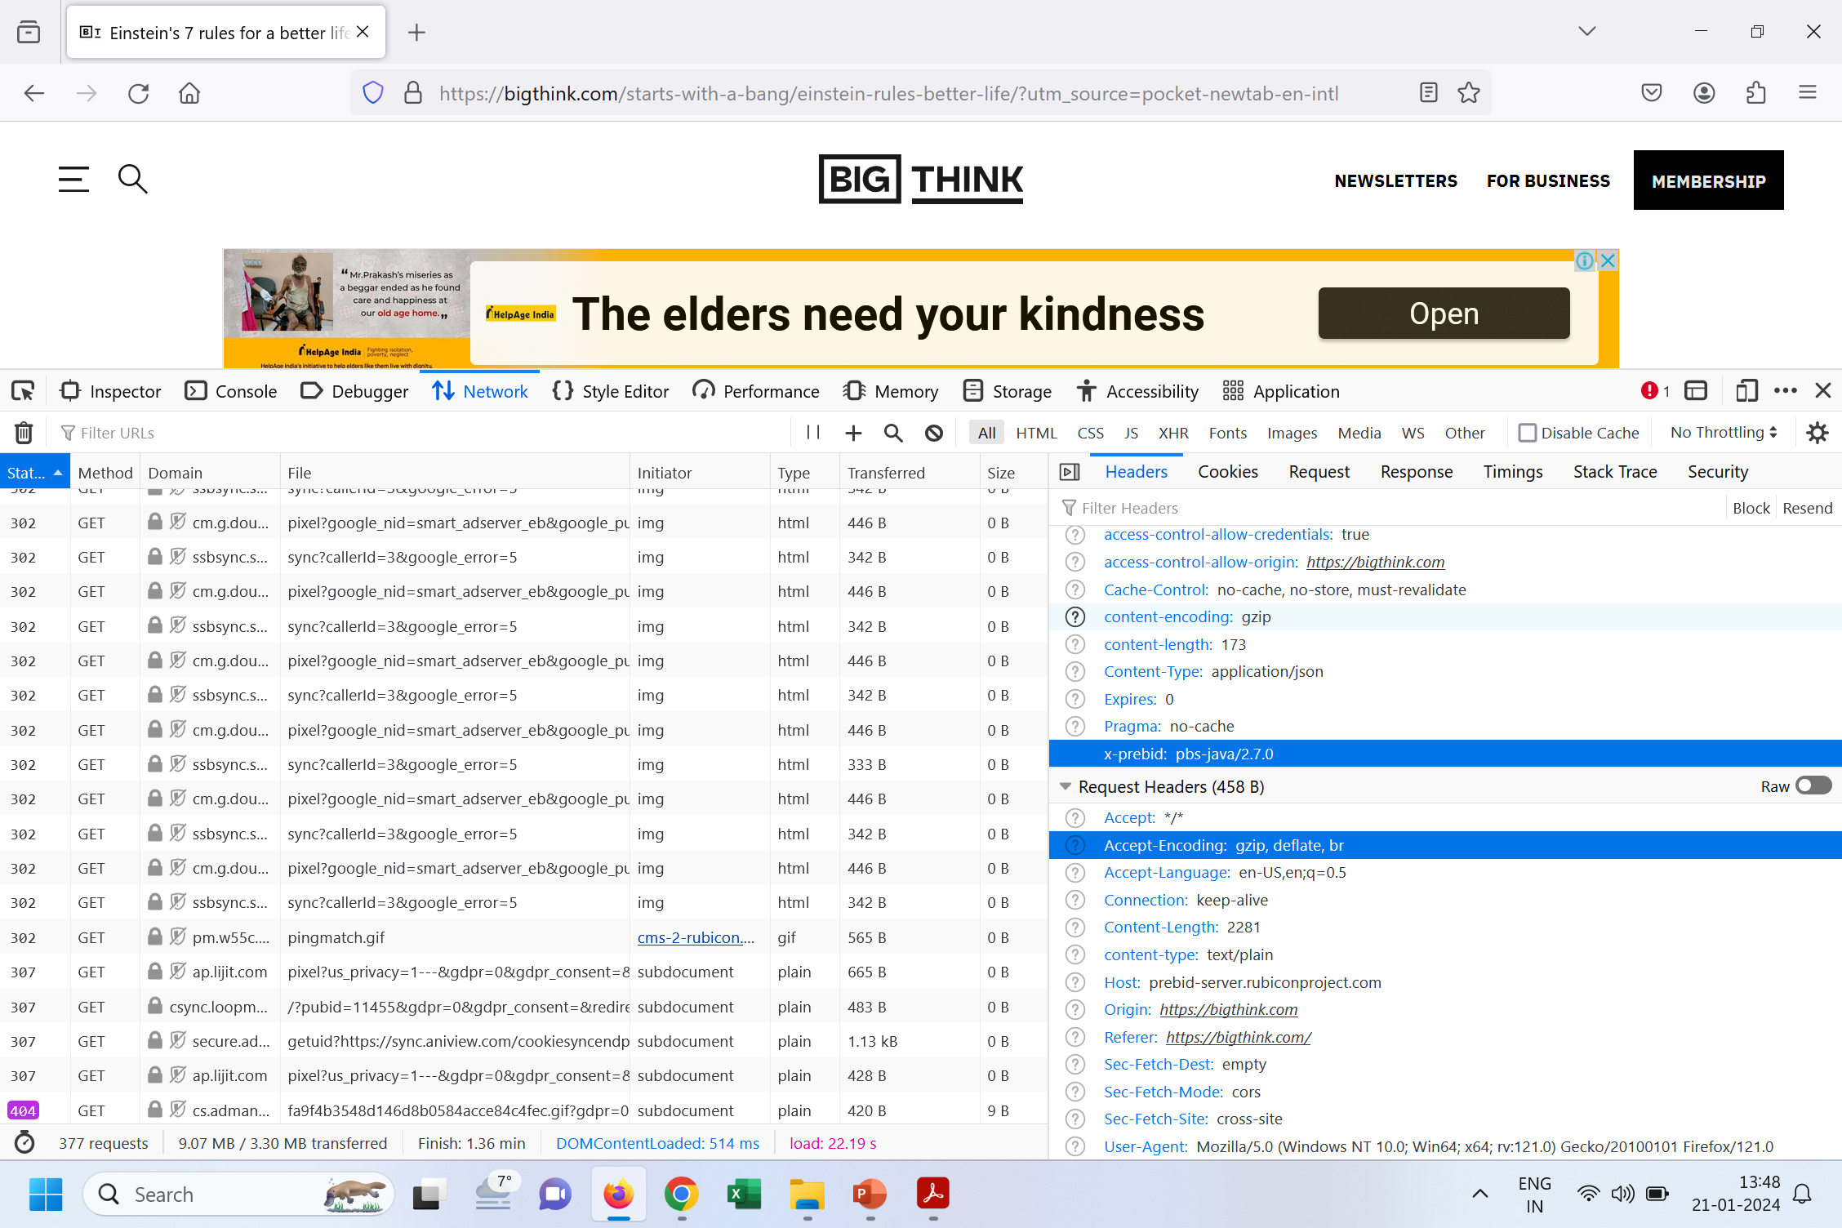

Slide 41
Rendering performance-auditing tools
Although minimizing load time is a big concern, another aspect of performance is a page’s rendering speed. The initial rendering of a page is important, but it’s also important that interactions with web pages after they render are smooth. In this section, you’ll learn the process by which pages render. You’ll also learn how to use Chrome’s Timeline tool, how to spot poor rendering performance, and how to mark points in the timeline with JavaScript. Finally, you’ll get an overview of similar tools in other browsers.

Slide 42
Understanding how browsers render web pages
When a user visits a website, the browser interprets the HTML and CSS and renders it to the screen. In detailed terms, the steps in this process are:
Parse HTML to create the Document Object Model (DOM): When the HTML is downloaded from the web server, it’s parsed by the browser to build the DOM, which is a hierarchical representation of the HTML document’s structure.
Parse CSS to create the CSS Object Model (CSSOM): After the DOM is built, the browser parses the CSS and creates the CSSOM. This is similar to the DOM, except it represents the way that CSS rules are applied to the document.

Slide 43
Lay out elements: The DOM and CSSOM trees are combined to create a render tree. The render tree then goes through the layout process, where CSS rules are applied and elements are laid out on the page to create the UI.
Paint page: After the document has finished the layout process, the cosmetic aspects of the page are applied from the CSS and media in the page. At the end of the painting process, the output is converted into pixels (rasterized) and displayed on the screen.
The bulk of the rendering for many sites is done when the page first loads, but more can occur beyond that point. As a user interacts with elements on a page, changes can occur to the page. These changes can trigger re-rendering. Next, you’ll learn how to use the Timeline tool to profile page activity and identify undesirable behaviors that occur on the page.

Slide 44
Using Google Chrome’s Timeline tool
You’re going to see a lot of data in the activity overview and in the flame chart. The sheer amount of information can be overwhelming, but let’s start with the basics. The tool captures four specific types of events, each of them color coded:
Loading (Blue): Network-related events such as HTTP requests. It also includes activity such as the parsing of HTML, CSS, and image decoding.
Scripting (Yellow): JavaScript-related events. These can range from DOM-specific activity, to garbage collection, to site-specific JavaScript, and to other activity.

Slide 45
Rendering (Purple): Any and all events relating to page rendering. Events in this category are activities such as applying CSS to the page HTML, and events that cause re-rendering such as changes to the page’s HTML triggered by JavaScript.
Painting (Green): Events related to drawing the layout to the screen, such as layer compositing and rasterization.

Slide 46
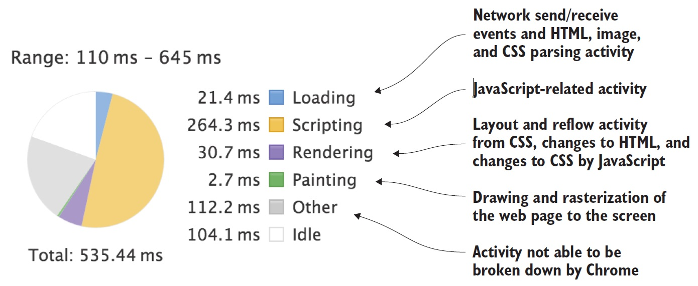
Using Google Chrome’s Timeline tool

Slide 47
Benchmarking JavaScript in Chrome
Benchmarking JavaScript gives you the ability to compare approaches to the problems you’re trying to solve, and tease out which is the best performing. By choosing the best-performing solutions, you’ll be creating pages that will render faster and respond more quickly to user input.

Slide 48
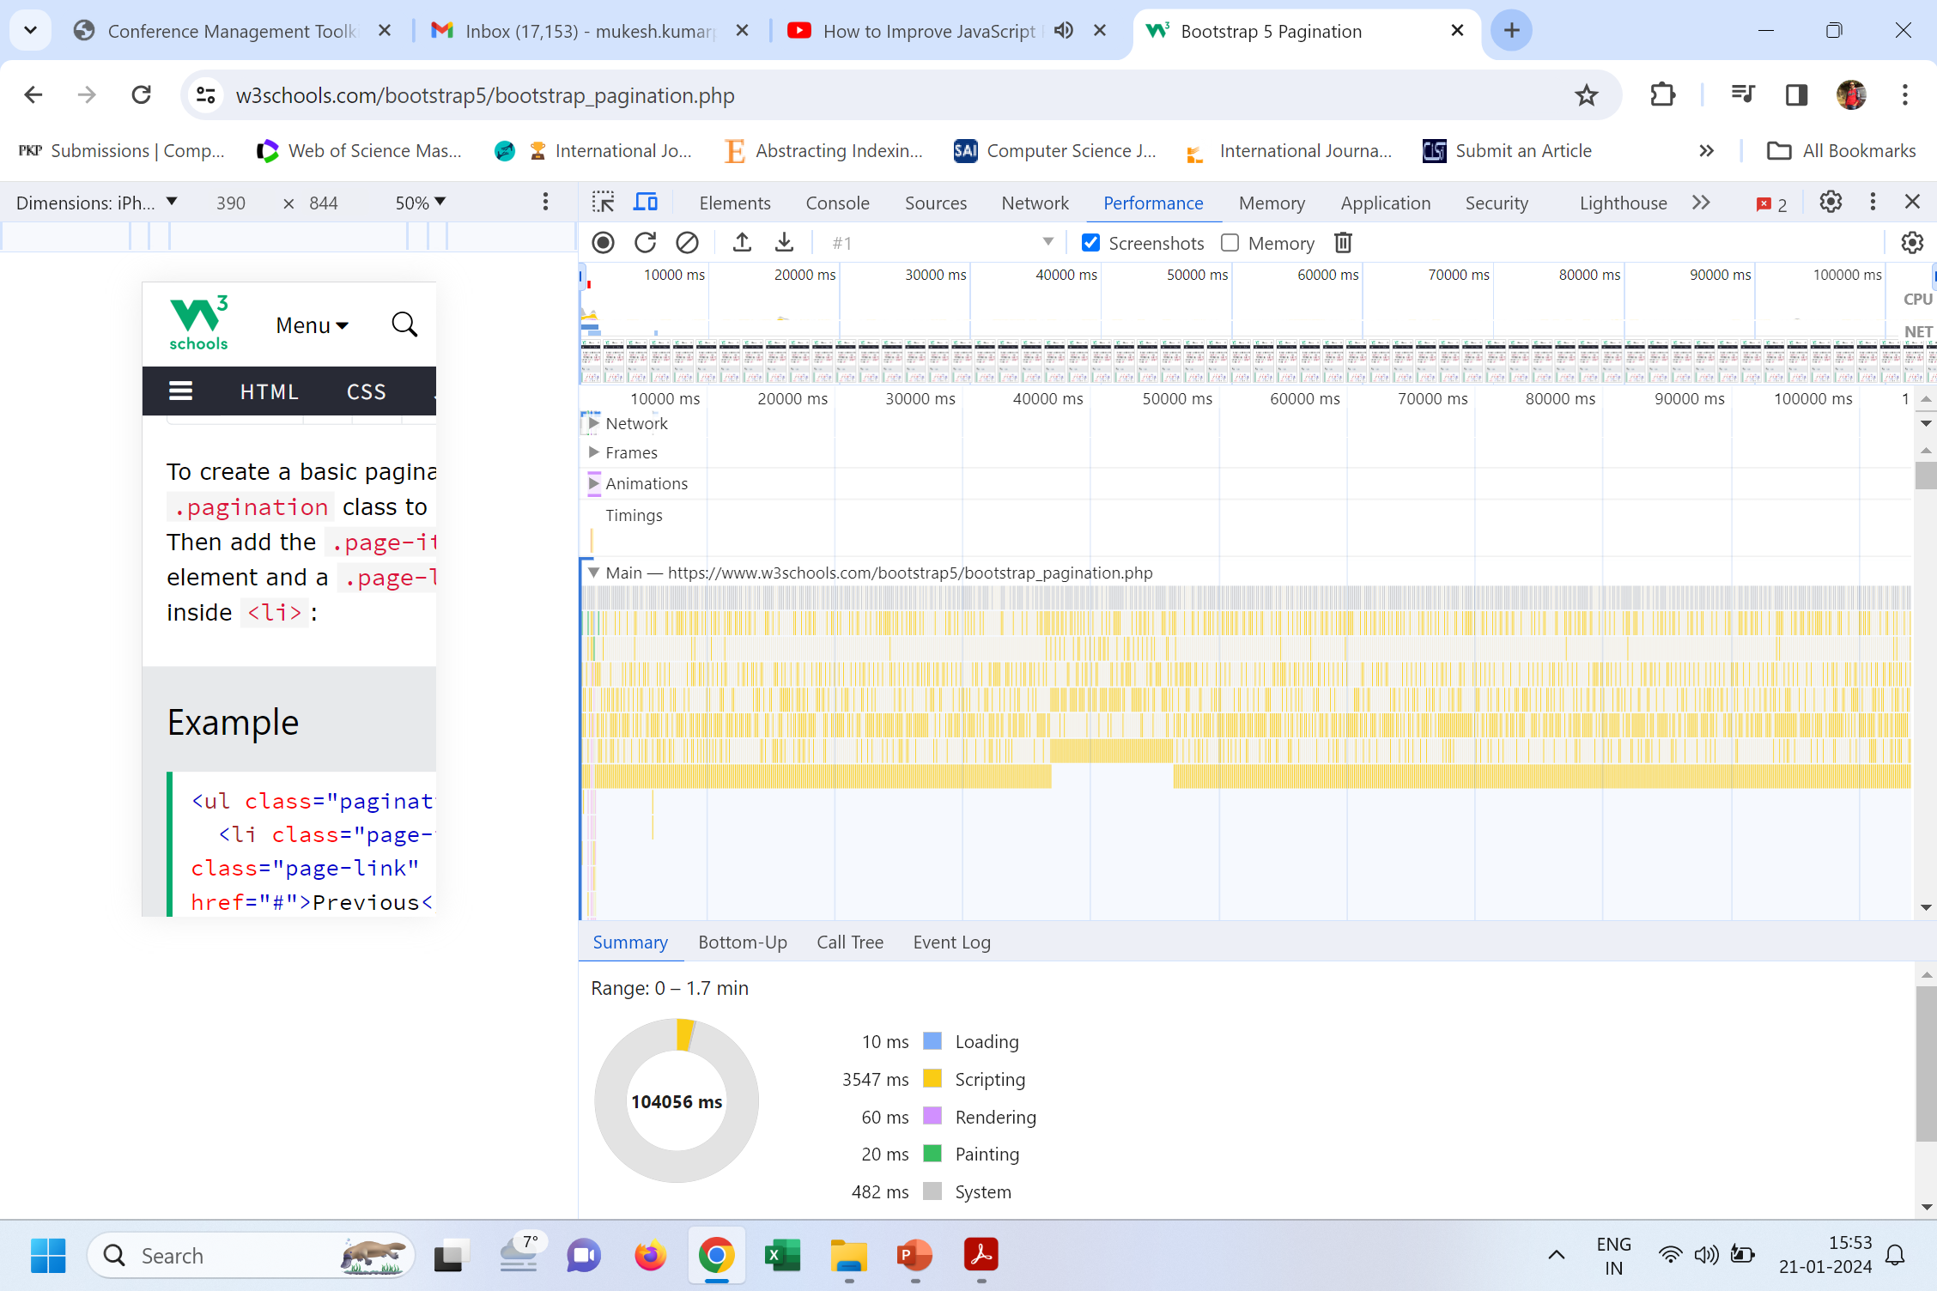

Slide 49
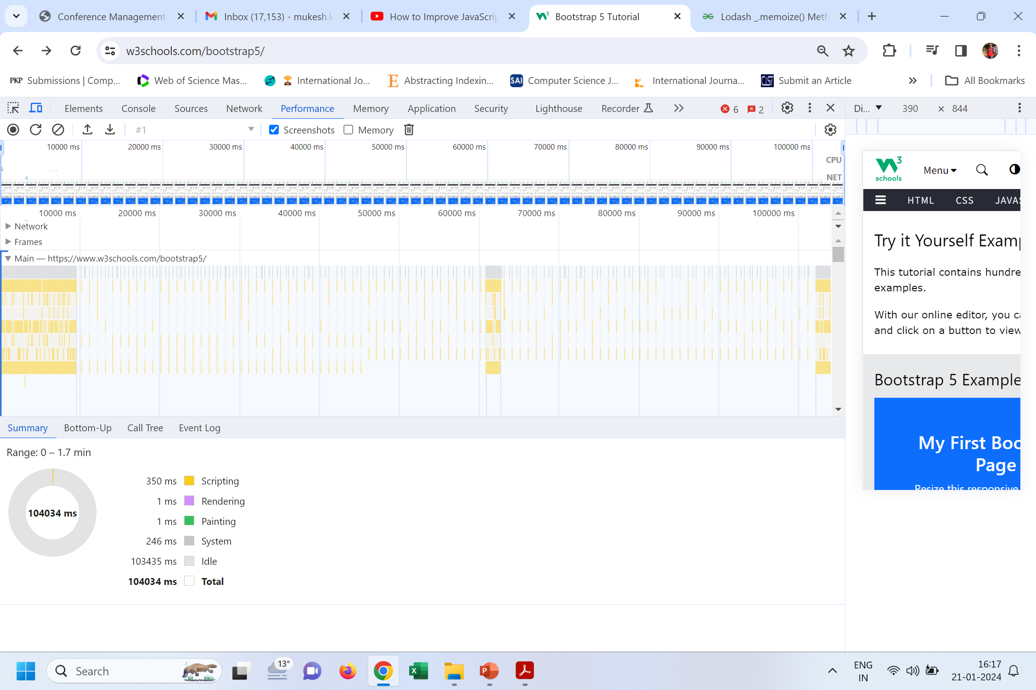

Slide 50
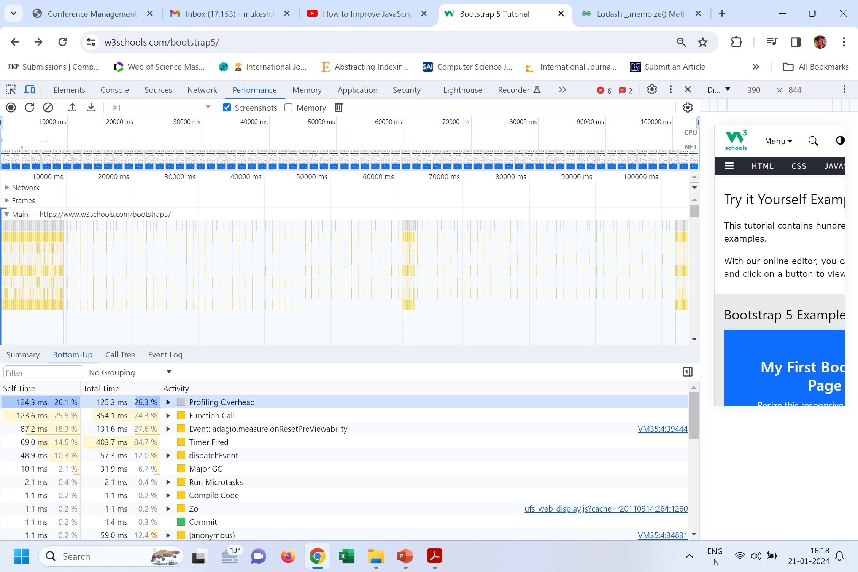

Slide 51
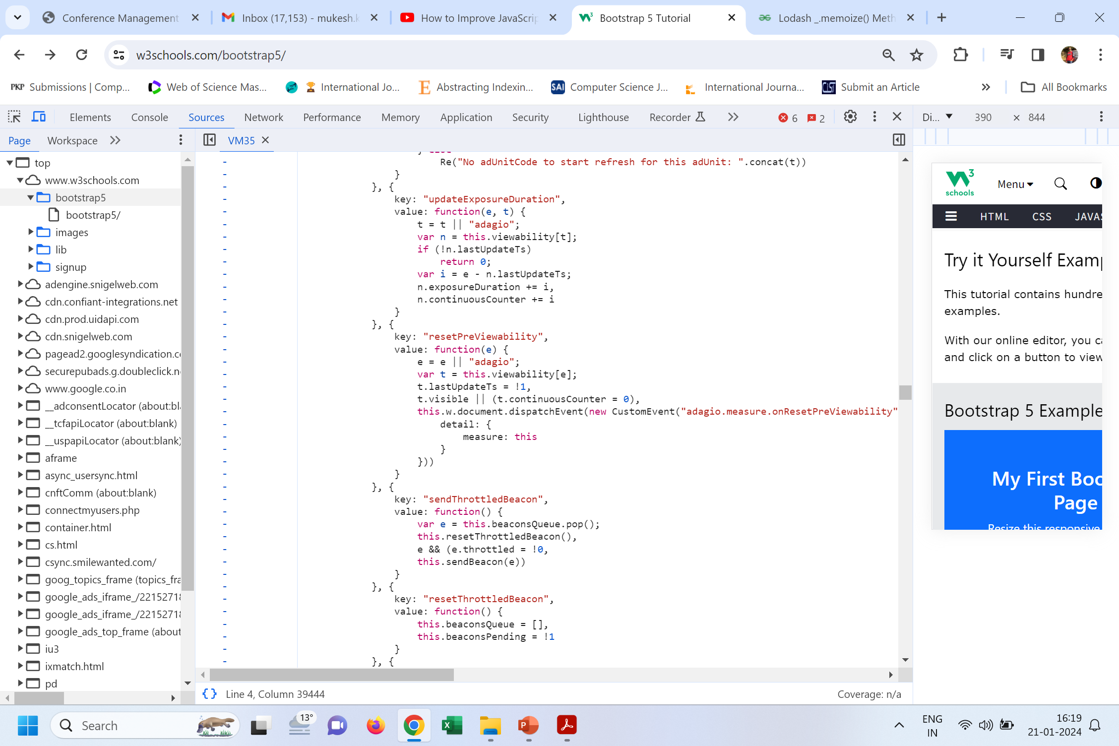

Slide 52
Memoized Functions Cache output based on Input:
Lodash _.memoize() method is used to memorize a given function by caching the result computed by the function. If the resolver is issued, the cache key for storing the result is determined based on the arguments given to the memoized method.
Import memorize from ‘lodash/memorize’.
Const Old_function_name = memoize(New_function_name);

Slide 53
Simulating and monitoring devices
As a developer, you spend a lot of time doing the initial testing for your websites in a desktop environment. This is typical, but further testing should be done with tools that simulate how your pages might look on mobile devices, and finally, on actual physical devices.

Slide 54
Simulating devices in the desktop web browser
The most simple way of checking your website’s appearance is by using device simulation tools across desktop web browsers. These tools cover only high-level characteristics such as device resolution and pixel density.
In Chrome, it’s easy to use Device Mode. To try it, you’ll navigate to a website—in this case, the Manning Publications website at www.manning.com. With the developer tools open, you can hit the Ctrl-Shift-M key combination (cmd-Shift-M on a Mac), or click the mobile device icon to the left of the Elements tab. When you do this, the interface changes, as shown in figure below.

Slide 55
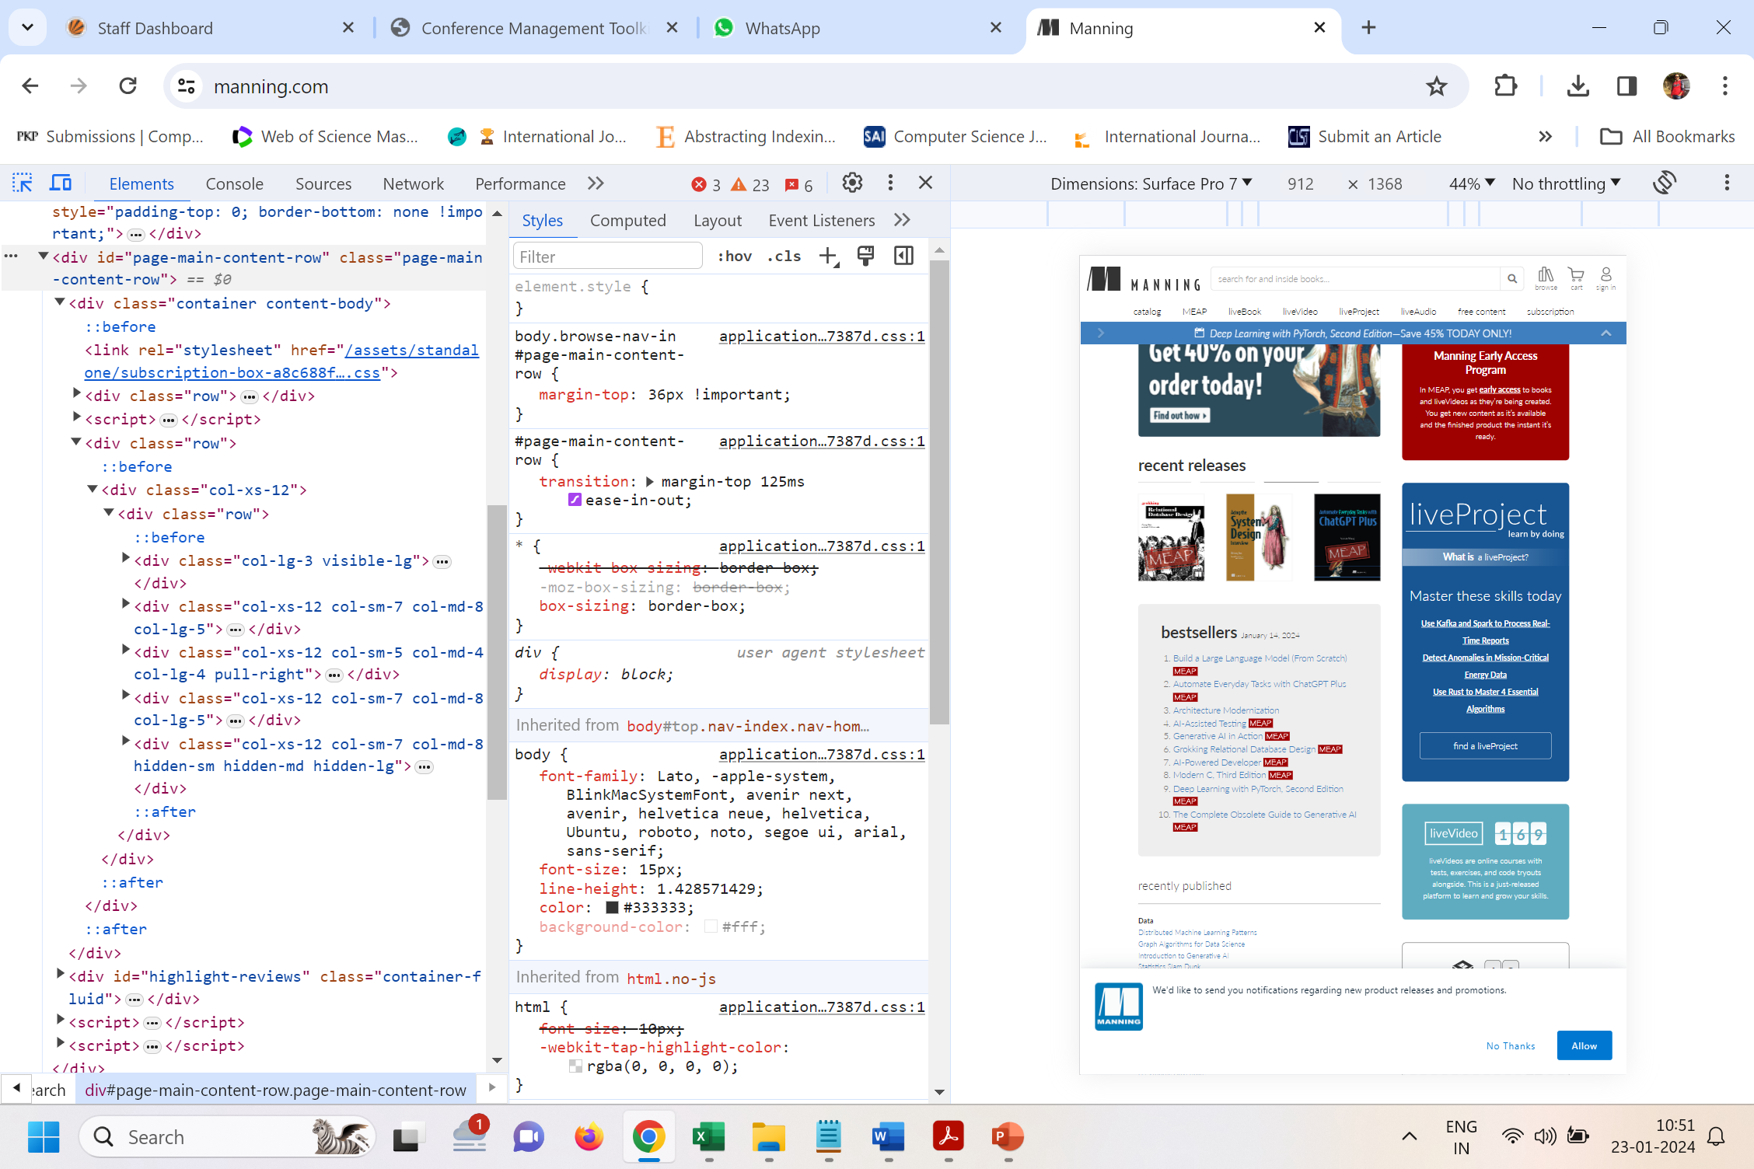

Slide 56
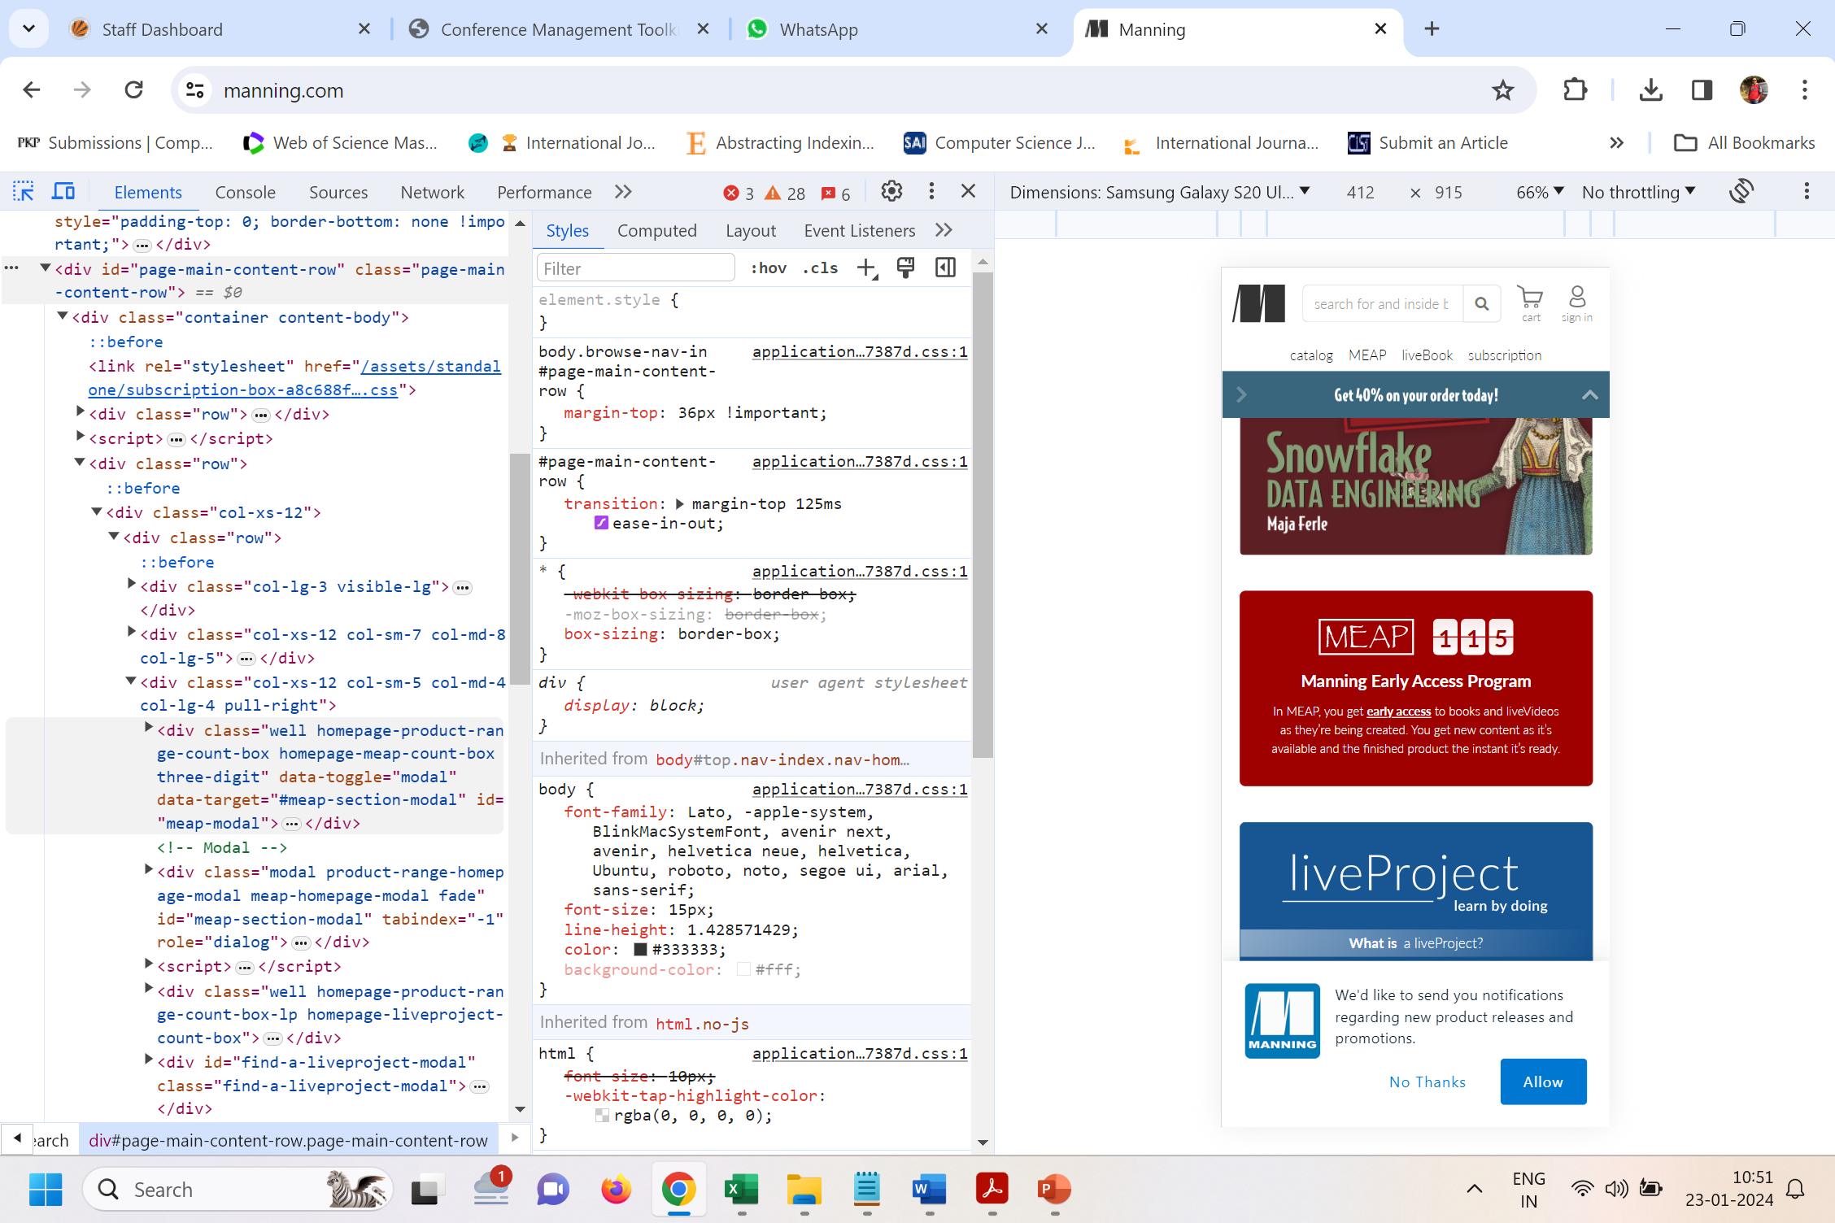

Slide 57
From this interface, you can pick a device profile from the drop-down list of presets, and simulate the characteristics of a selected preset in the current page. As you can see in figure above, you have several things to tinker with. You can switch to a canned device profile (for example, iPhone or Galaxy Nexus), key in a custom resolution, change the device pixel ratio to debug issues related to high-density displays, and more.

Slide 58
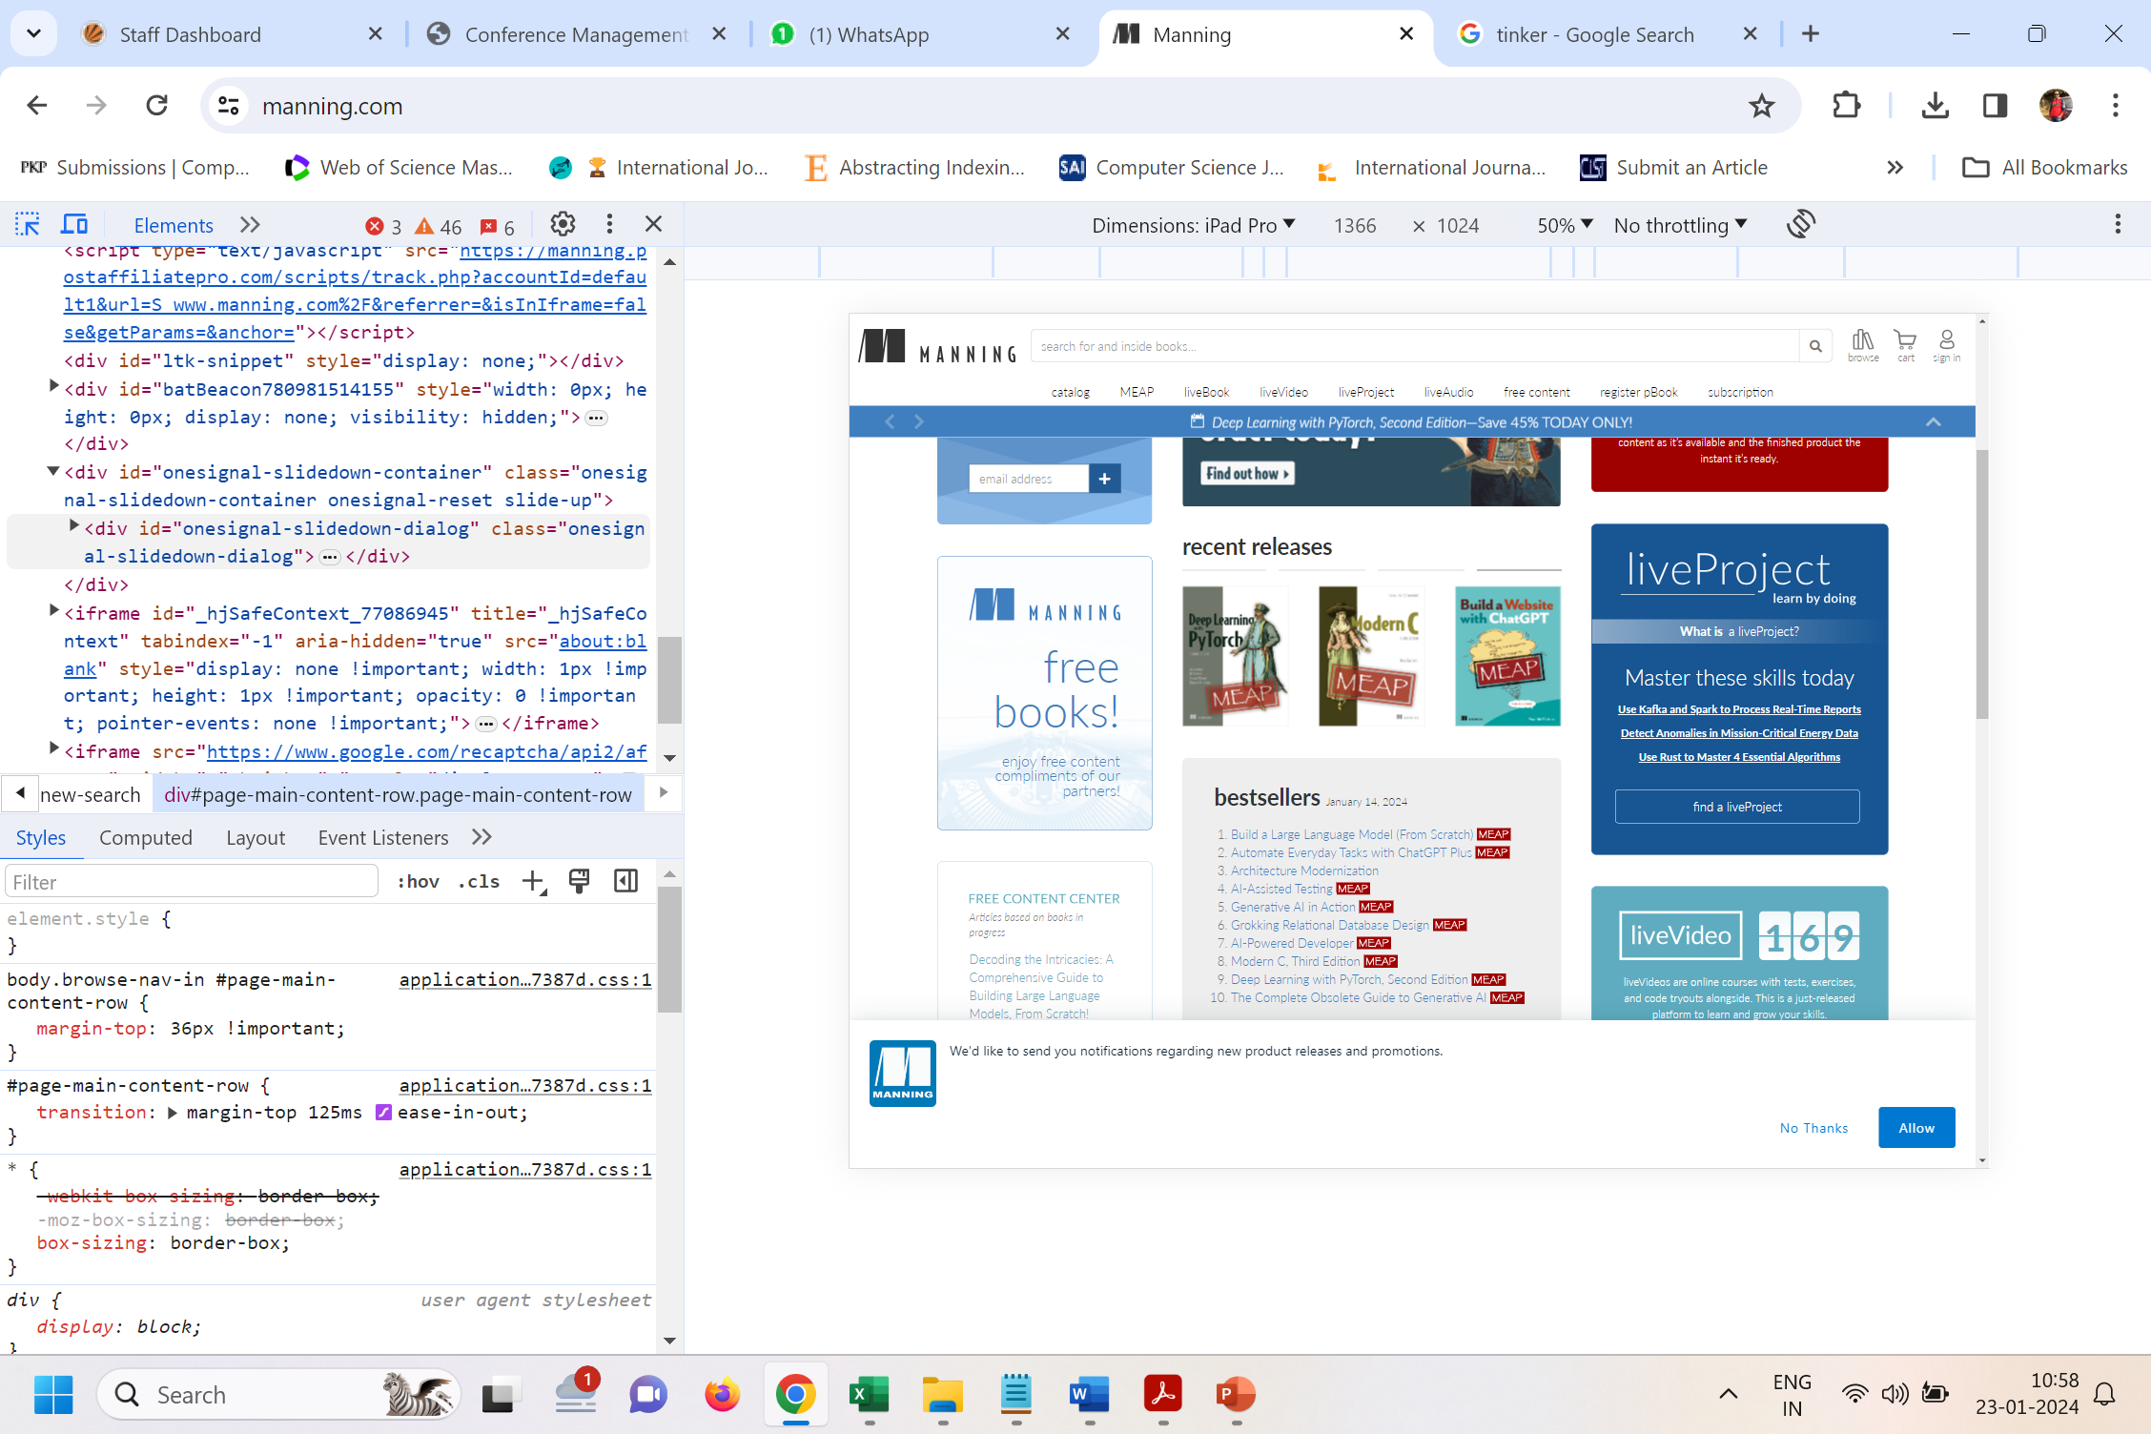

Slide 59
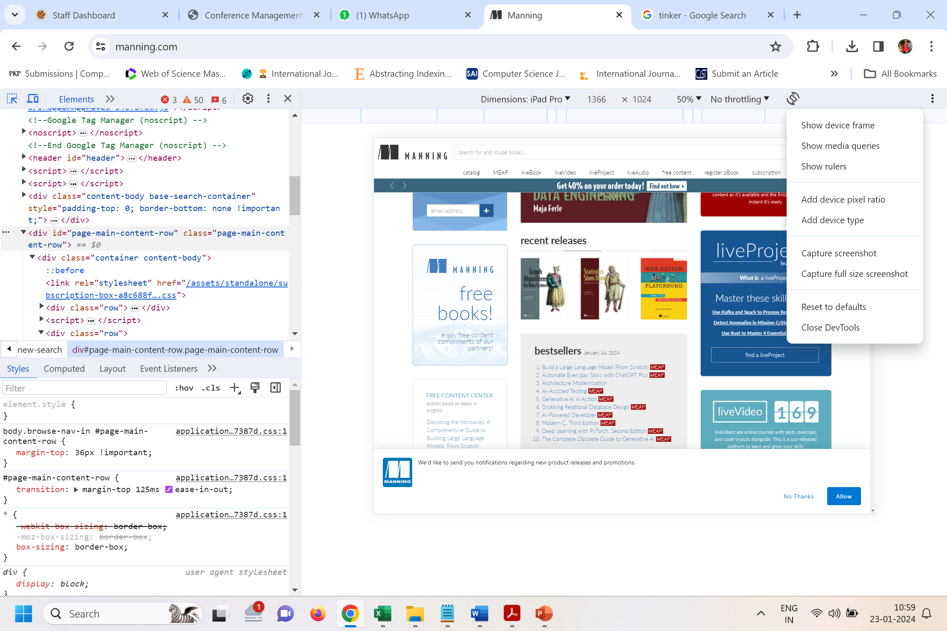

Slide 60
Other web browsers have similar utilities. Safari has an iOS-centric device simulation utility called Responsive Design Mode. You invoke this mode from the Develop menu by clicking Enter Responsive Design Mode, or by hitting Alt-cmd-R. This utility is similar to Chrome’s in capability, but with a different UI. Firefox’s Responsive Design Mode is similar to Chrome’s, but with fewer options overall. Edge is similar as well, and focuses on simulating Microsoft-centric mobile devices and Internet Explorer. Although simulating devices in your desktop browser can be useful, don’t forget to test on mobile devices to catch problems that browser-based tools may miss. Next, you’ll learn how to attach Android devices and monitor their activity in the desktop version of Chrome.

Slide 61
Debugging websites remotely on Android devices
Sometimes you need to test your site on a real device. Browser-based tools such as the ones covered in the previous section are great for debugging and performance profiling, but desktop devices have much more memory and processing power to work with than mobile devices. It’s important to test on the real thing to see whether performance problems exist on those platforms.
The way to do this is to connect your mobile device to your desktop computer, and debug it by using the developer tools in one of the browsers. The way this is accomplished depends on the device you have. For Android devices, you’ll use Chrome.

Slide 62
Chrome calls this feature remote debugging. To use it, connect your Android device to your machine with a USB cable, and open Chrome on both your mobile and desktop devices. Follow these directions, and your Android device will show up in the device list in Chrome’s remote debugger on your desktop.
To get started with remote debugging, complete the following steps:

Slide 63
Enable the developer options on the Android device: This entails choosing Settings > About Device and tapping the build number field seven times (seriously).
Enable USB debugging: On the Android device, choose Settings > Developer Options and then select the USB Debugging check box.
Allow device authorization: In Chrome on your desktop, go to the URL chrome://inspect#devices and ensure that the Discover USB Devices check box is selected. This enables you to receive an authorization request inside Chrome on the attached device. Tap OK to accept it.
Inspect the web page open on the device: After a device appears in the device list, click the Inspect link underneath the device in the list.

Slide 64
Creating custom network throttling profiles
You used the network throttling tool in Chrome. This tool allows you to simulate certain internet connections, such as 3G or 4G connections. This is valuable for determining page-load times in scenarios you may not be able to otherwise replicate.

Slide 65
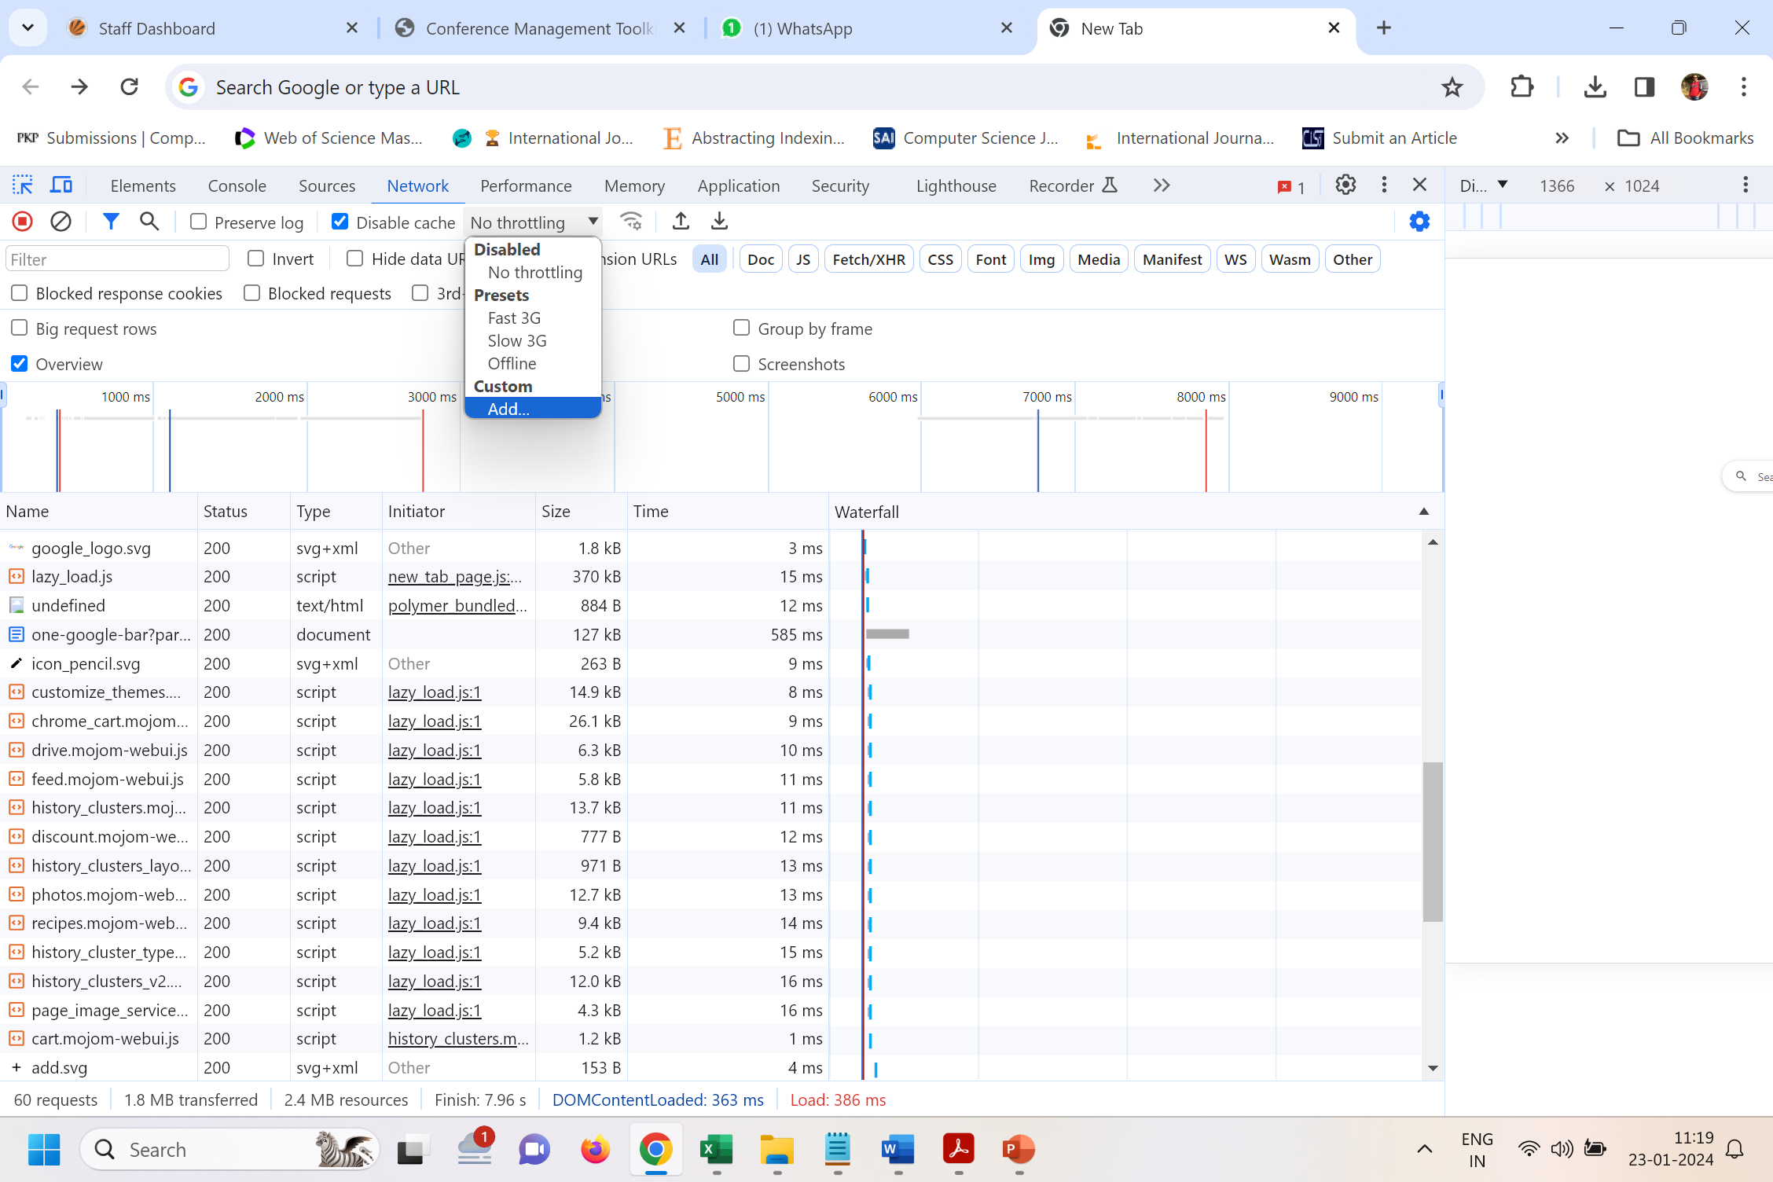

Slide 66
If you do need to test for a specific scenario, you can add a custom profile via the Add option, as seen in figure below. Click this, and you’ll be sent to the Network Throttling Profiles settings screen, where you can add a new profile by clicking the Add Custom Profile button. When you do this, a screen like figure below appears.
This screen displays the following set of fields:

Slide 67
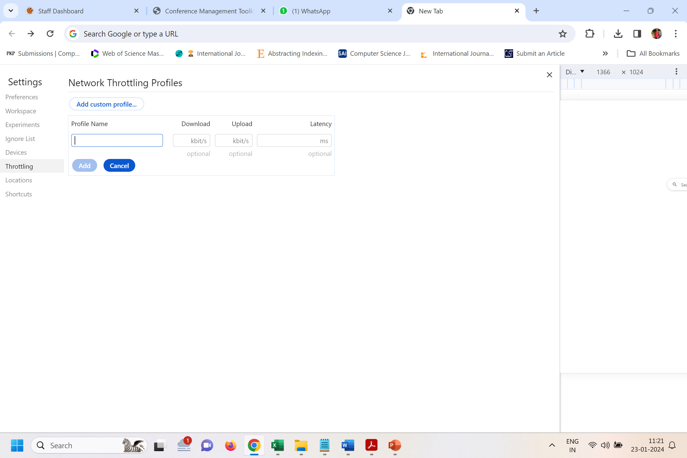

Slide 68
Profile Name: A name for the profile. What you enter here will appear by this name in the throttling profile drop-down list.
Throughput: The connection speed of the profile in kilobytes.
Latency: The connection latency of the profile in milliseconds.
After the profile has been added, it’ll will be visible in the drop-down list, as shown in figure below. Now you can use your custom profile and see how it affects the load times of websites. When you use it, watch the Network tab as sites load to see your new profile in action.
Now that you have a handle on how to use the performance assessment tools in different browsers.

Slide 69
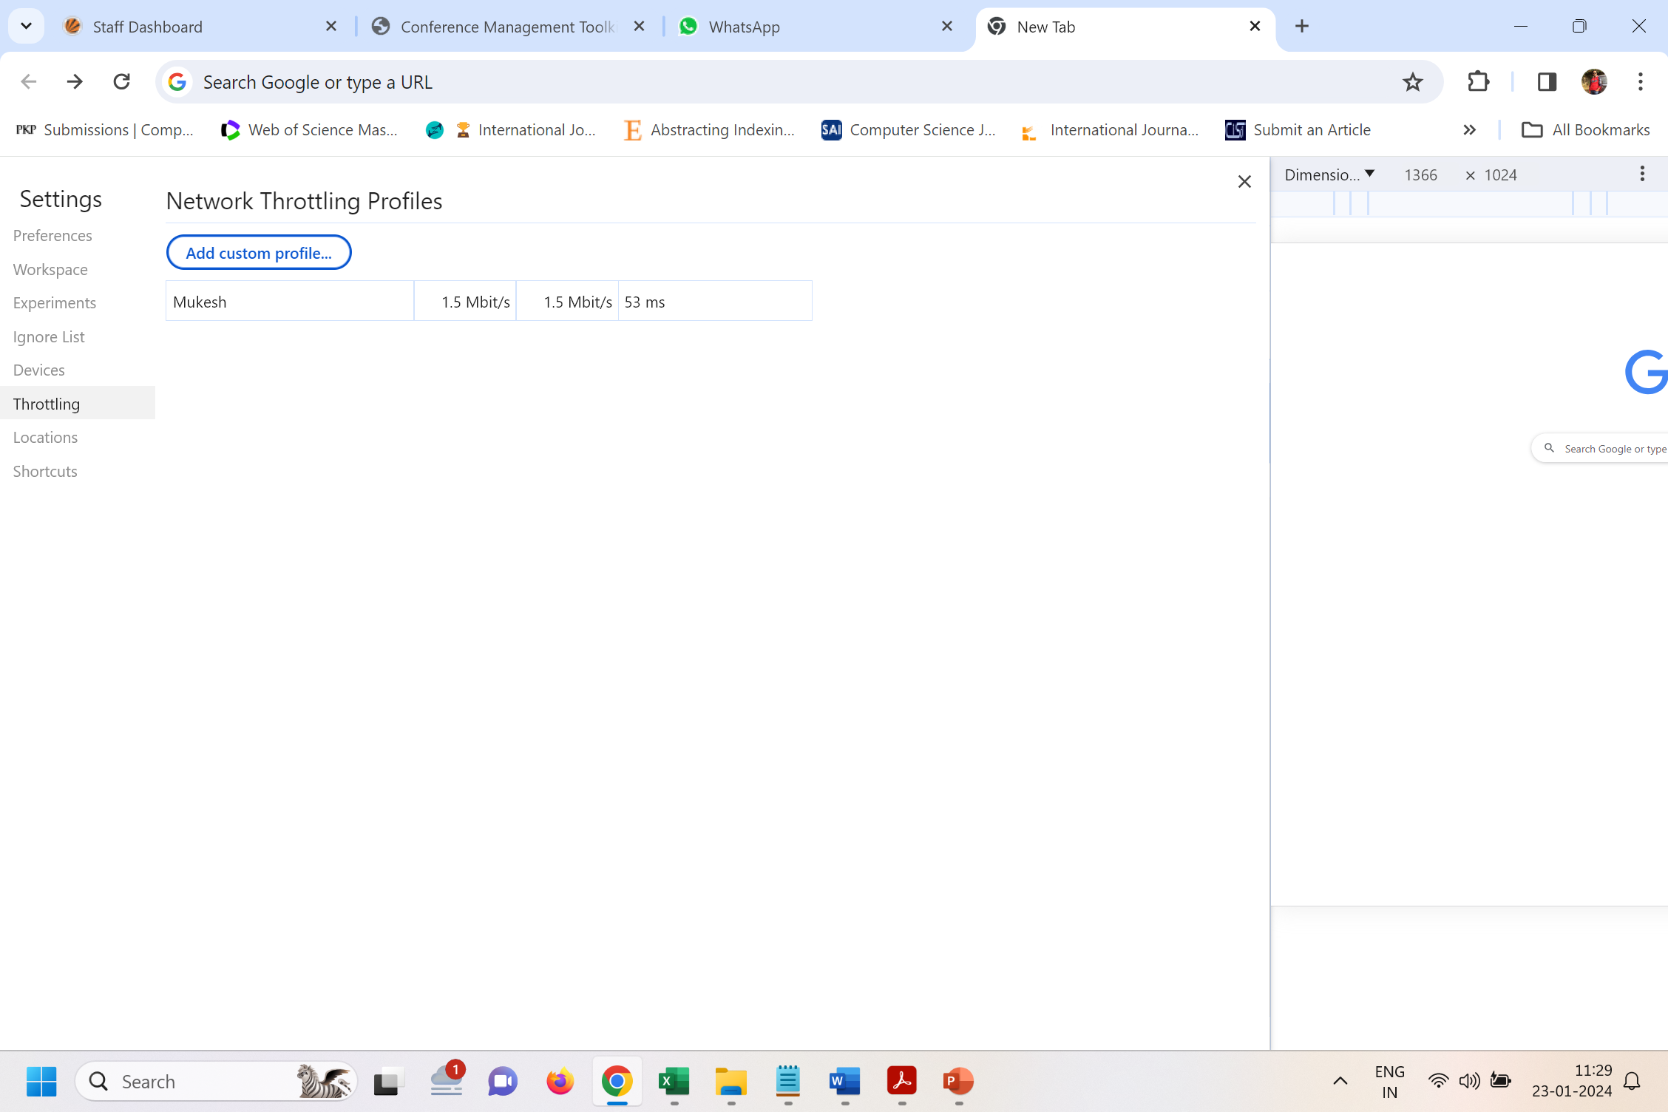

Slide 70
